Slide 1
MODERN OPERATING SYSTEMS
Third Edition
ANDREW S. TANENBAUM
Chapter 8
Multiple Processor Systems
Tanenbaum, Modern Operating Systems 3 e, (c) 2008 Prentice-Hall, Inc. All rights reserved. 0-13-6006639

Slide 2
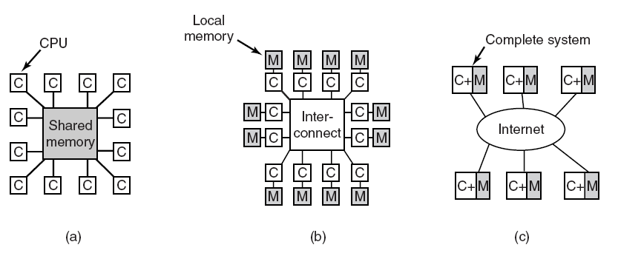
Multiple Processor Systems
Figure 8-1. (a) A shared-memory multiprocessor. (b) A message-passing multicomputer. (c) A wide area distributed system.
Tanenbaum, Modern Operating Systems 3 e, (c) 2008 Prentice-Hall, Inc. All rights reserved. 0-13-6006639

Slide 3
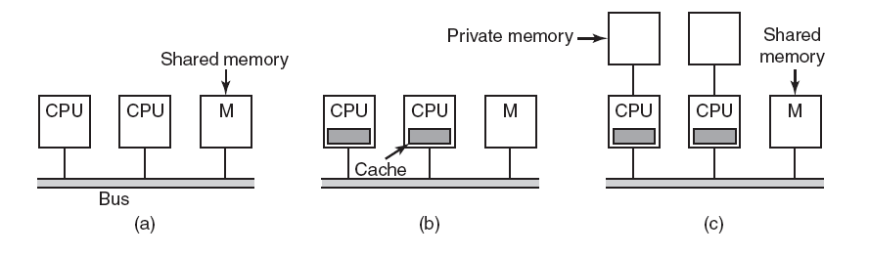
UMA Multiprocessors with
Bus-Based Architectures
Figure 8-2. Three bus-based multiprocessors. (a) Without caching. (b) With caching. (c) With caching and private memories.
Tanenbaum, Modern Operating Systems 3 e, (c) 2008 Prentice-Hall, Inc. All rights reserved. 0-13-6006639

Slide 4
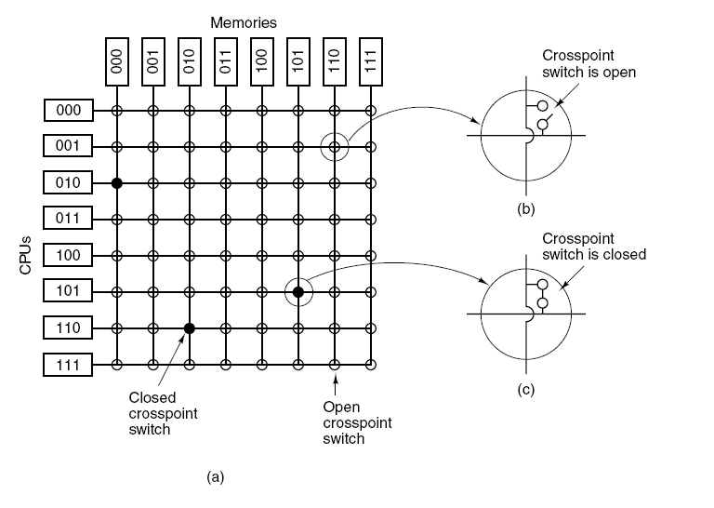
UMA Multiprocessors
Using Crossbar Switches
Figure 8-3. (a) An 8 × 8 crossbar switch. (b) An open crosspoint. (c) A closed crosspoint.
Tanenbaum, Modern Operating Systems 3 e, (c) 2008 Prentice-Hall, Inc. All rights reserved. 0-13-6006639

Slide 5
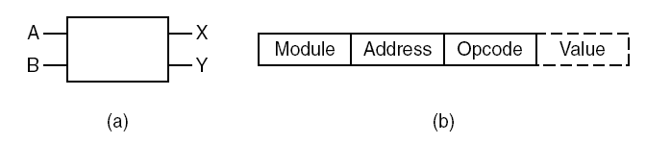
UMA Multiprocessors Using Multistage Switching Networks (1)
Figure 8-4. (a) A 2 × 2 switch with two input lines, A and B, and two output lines, X and Y. (b) A message format.
Tanenbaum, Modern Operating Systems 3 e, (c) 2008 Prentice-Hall, Inc. All rights reserved. 0-13-6006639

Slide 6
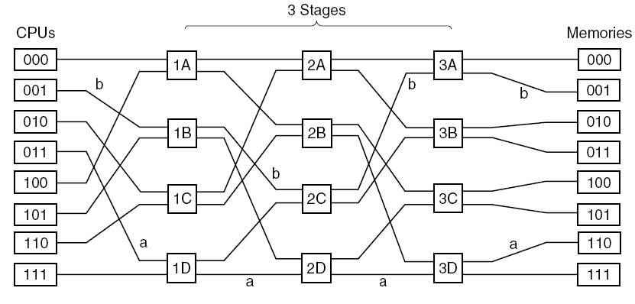
UMA Multiprocessors Using Multistage Switching Networks (2)
Figure 8-5. An omega switching network.
Tanenbaum, Modern Operating Systems 3 e, (c) 2008 Prentice-Hall, Inc. All rights reserved. 0-13-6006639

Slide 7
NUMA Multiprocessors (1)
Characteristics of NUMA machines:
There is a single address space visible to all CPUs.
Access to remote memory is via LOAD and STORE instructions.
Access to remote memory is slower than access to local memory.
Tanenbaum, Modern Operating Systems 3 e, (c) 2008 Prentice-Hall, Inc. All rights reserved. 0-13-6006639

Slide 8
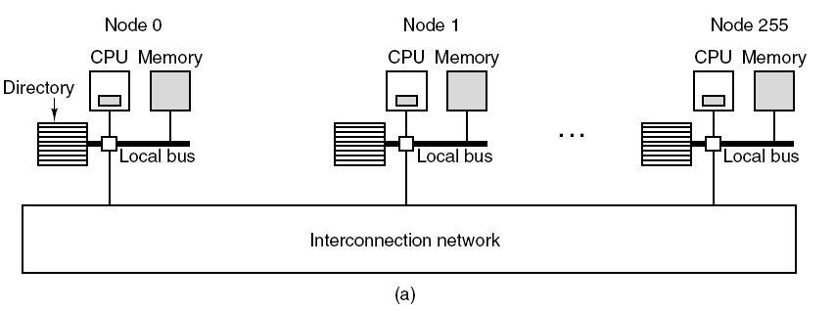
NUMA Multiprocessors (2)
Figure 8-6. (a) A 256-node directory-based multiprocessor.
Tanenbaum, Modern Operating Systems 3 e, (c) 2008 Prentice-Hall, Inc. All rights reserved. 0-13-6006639

Slide 9
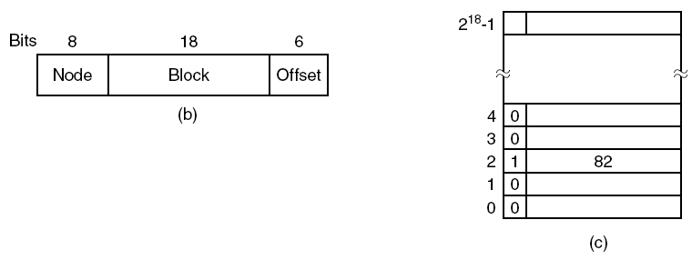
NUMA Multiprocessors (3)
Figure 8-6. (b) Division of a 32-bit memory address into fields.
(c) The directory at node 36.
Tanenbaum, Modern Operating Systems 3 e, (c) 2008 Prentice-Hall, Inc. All rights reserved. 0-13-6006639

Slide 10
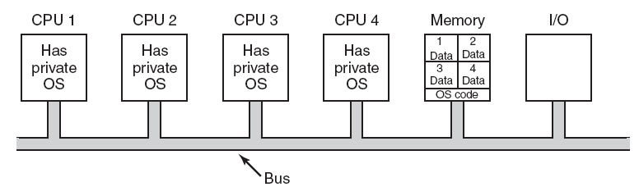
Each CPU Has Its Own
Operating System
Figure 8-7. Partitioning multiprocessor memory among four CPUs, but sharing a single copy of the operating system code.
The boxes marked Data are the operating
system’s private data for each CPU.
Tanenbaum, Modern Operating Systems 3 e, (c) 2008 Prentice-Hall, Inc. All rights reserved. 0-13-6006639

Slide 11
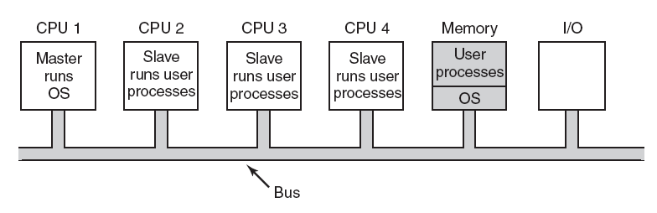
Master-Slave Multiprocessors
Figure 8-8. A master-slave multiprocessor model.
Tanenbaum, Modern Operating Systems 3 e, (c) 2008 Prentice-Hall, Inc. All rights reserved. 0-13-6006639

Slide 12
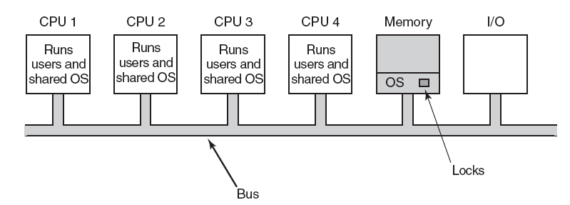
Symmetric Multiprocessors
Figure 8-9. The SMP multiprocessor model.
Tanenbaum, Modern Operating Systems 3 e, (c) 2008 Prentice-Hall, Inc. All rights reserved. 0-13-6006639

Slide 13
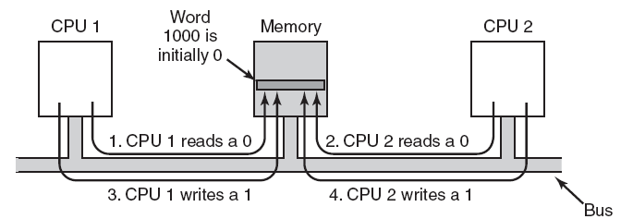
Multiprocessor Synchronization (1)
Figure 8-10. The TSL instruction can fail if the bus cannot be locked. These four steps show a sequence of events where the failure is demonstrated.
Tanenbaum, Modern Operating Systems 3 e, (c) 2008 Prentice-Hall, Inc. All rights reserved. 0-13-6006639

Slide 14
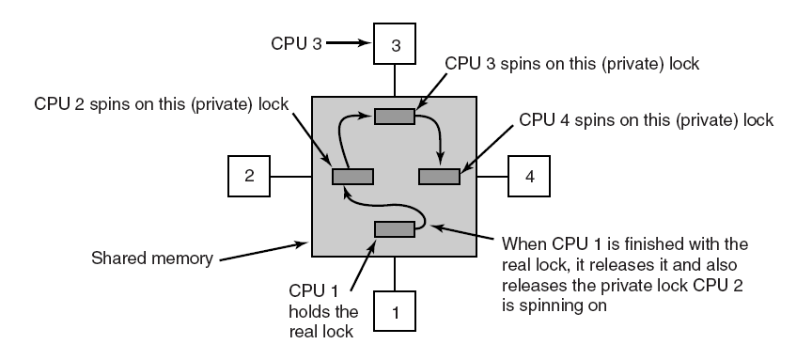
Multiprocessor Synchronization (2)
Figure 8-11. Use of multiple locks to avoid cache thrashing.
Tanenbaum, Modern Operating Systems 3 e, (c) 2008 Prentice-Hall, Inc. All rights reserved. 0-13-6006639

Slide 15
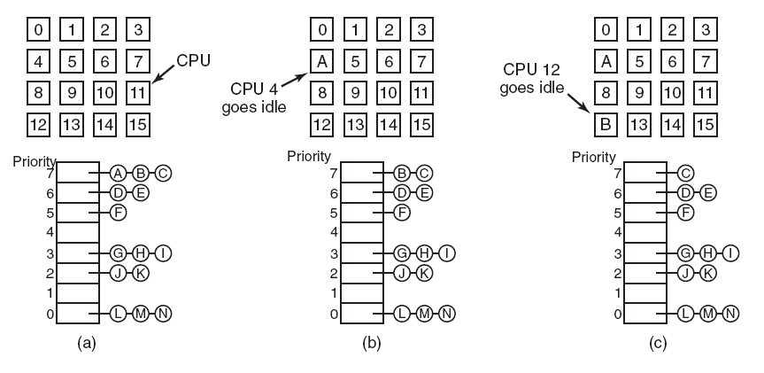
Timesharing
Figure 8-12. Using a single data structure for scheduling a multiprocessor.
Tanenbaum, Modern Operating Systems 3 e, (c) 2008 Prentice-Hall, Inc. All rights reserved. 0-13-6006639

Slide 16
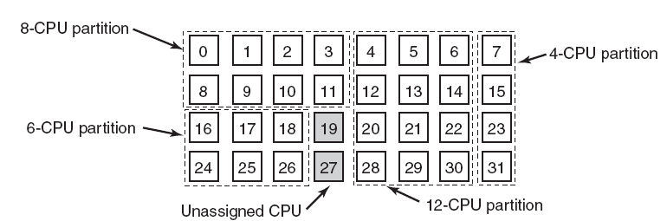
Space Sharing
Figure 8-13. A set of 32 CPUs split into four partitions,
with two CPUs available.
Tanenbaum, Modern Operating Systems 3 e, (c) 2008 Prentice-Hall, Inc. All rights reserved. 0-13-6006639

Slide 17
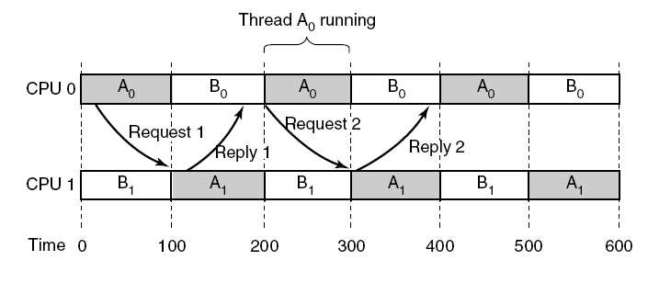
Gang Scheduling (1)
Figure 8-14. Communication between two threads belonging to thread A that are running out of phase.
Tanenbaum, Modern Operating Systems 3 e, (c) 2008 Prentice-Hall, Inc. All rights reserved. 0-13-6006639

Slide 18
Gang Scheduling (2)
The three parts of gang scheduling:
Groups of related threads are scheduled as a unit, a gang.
All members of a gang run simultaneously, on different timeshared CPUs.
All gang members start and end their time slices together.
Tanenbaum, Modern Operating Systems 3 e, (c) 2008 Prentice-Hall, Inc. All rights reserved. 0-13-6006639

Slide 19
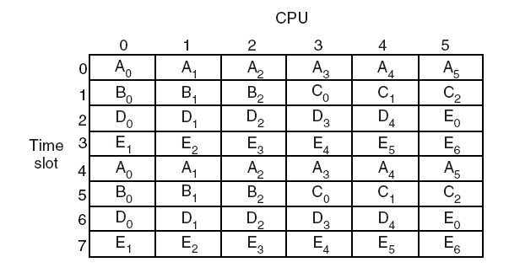
Gang Scheduling (3)
Figure 8-15. Gang scheduling.
Tanenbaum, Modern Operating Systems 3 e, (c) 2008 Prentice-Hall, Inc. All rights reserved. 0-13-6006639

Slide 20
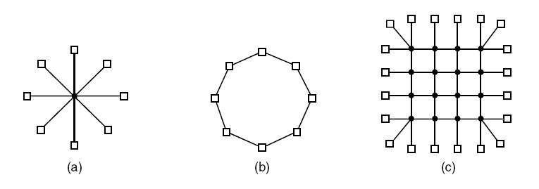
Interconnection Technology (1)
Figure 8-16. Various interconnect topologies.
(a) A single switch. (b) A ring. (c) A grid.
Tanenbaum, Modern Operating Systems 3 e, (c) 2008 Prentice-Hall, Inc. All rights reserved. 0-13-6006639

Slide 21
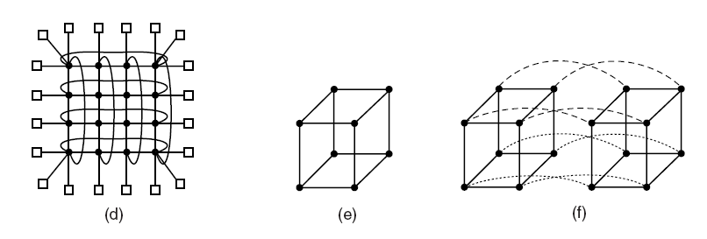
Interconnection Technology (2)
Figure 8-16. Various interconnect topologies.
(d) A double torus. (e) A cube. (f) A 4D hypercube.
Tanenbaum, Modern Operating Systems 3 e, (c) 2008 Prentice-Hall, Inc. All rights reserved. 0-13-6006639

Slide 22
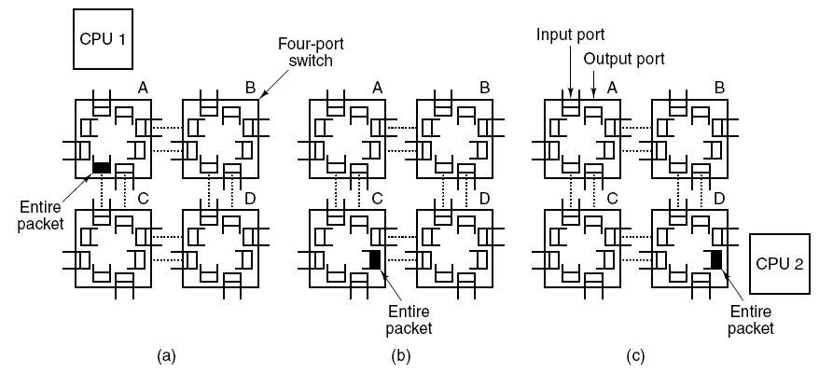
Interconnection Technology (3)
Figure 8-17. Store-and-forward packet switching.
Tanenbaum, Modern Operating Systems 3 e, (c) 2008 Prentice-Hall, Inc. All rights reserved. 0-13-6006639

Slide 23
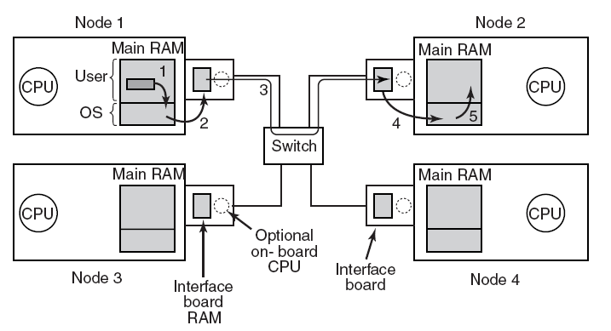
Network Interfaces
Figure 8-18. Position of the network interface boards
in a multicomputer.
Tanenbaum, Modern Operating Systems 3 e, (c) 2008 Prentice-Hall, Inc. All rights reserved. 0-13-6006639

Slide 24
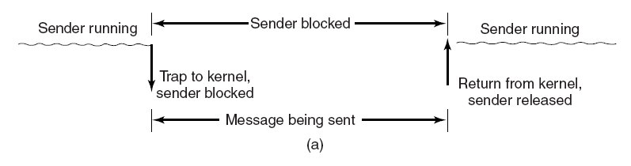
Blocking versus Nonblocking Calls (1)
Figure 8-19. (a) A blocking send call.
Tanenbaum, Modern Operating Systems 3 e, (c) 2008 Prentice-Hall, Inc. All rights reserved. 0-13-6006639

Slide 25
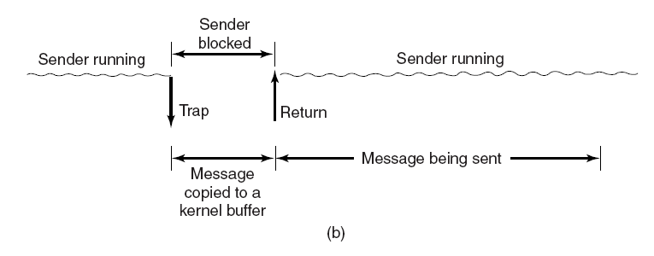
Blocking versus Nonblocking Calls (2)
Figure 8-19. (b) A nonblocking send call.
Tanenbaum, Modern Operating Systems 3 e, (c) 2008 Prentice-Hall, Inc. All rights reserved. 0-13-6006639

Slide 26
Blocking versus Nonblocking Calls (3)
Choices on the sending side:
Blocking send (CPU idle during message transmission).
Nonblocking send with copy (CPU time wasted for the extra copy).
Nonblocking send with interrupt (makes programming difficult).
Copy on write (extra copy probably needed eventually).
Tanenbaum, Modern Operating Systems 3 e, (c) 2008 Prentice-Hall, Inc. All rights reserved. 0-13-6006639

Slide 27
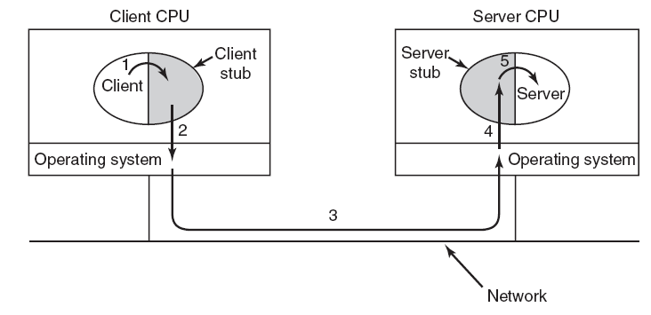
Remote Procedure Call
Figure 8-20. Steps in making a remote procedure call.
The stubs are shaded gray.
Tanenbaum, Modern Operating Systems 3 e, (c) 2008 Prentice-Hall, Inc. All rights reserved. 0-13-6006639

Slide 28
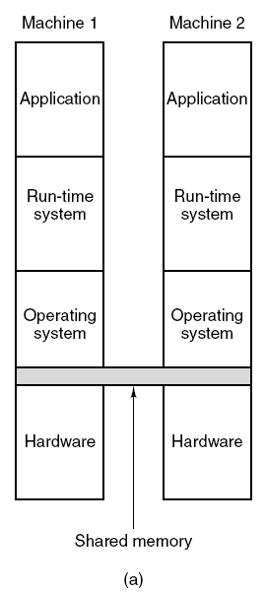
Distributed Shared Memory (1)
Figure 8-21. Various layers where shared memory can be implemented.
(a) The hardware.
Tanenbaum, Modern Operating Systems 3 e, (c) 2008 Prentice-Hall, Inc. All rights reserved. 0-13-6006639

Slide 29
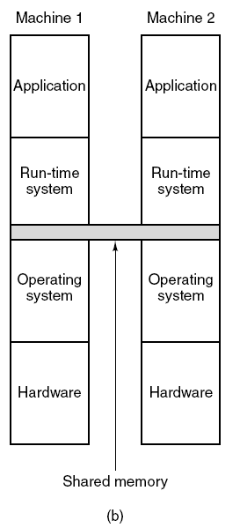
Distributed Shared Memory (2)
Figure 8-21. Various layers where shared memory can be implemented.
(b) The operating system.
Tanenbaum, Modern Operating Systems 3 e, (c) 2008 Prentice-Hall, Inc. All rights reserved. 0-13-6006639

Slide 30
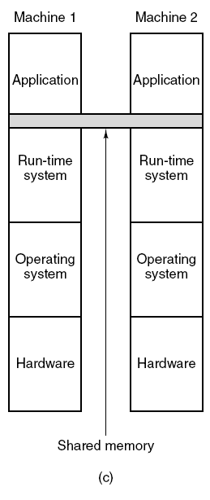
Distributed Shared Memory (3)
Figure 8-21. Various layers where shared memory can be implemented.
(c) User-level software.
Tanenbaum, Modern Operating Systems 3 e, (c) 2008 Prentice-Hall, Inc. All rights reserved. 0-13-6006639

Slide 31
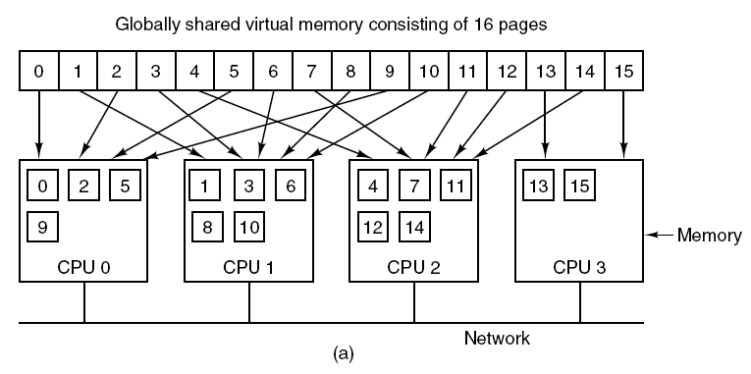
Distributed Shared Memory (4)
Figure 8-22. (a) Pages of the address space
distributed among four machines.
Tanenbaum, Modern Operating Systems 3 e, (c) 2008 Prentice-Hall, Inc. All rights reserved. 0-13-6006639

Slide 32
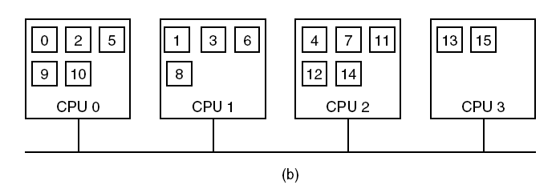
Distributed Shared Memory (5)
Figure 8-22. (b) Situation after CPU 1 references
page 10 and the page is moved there.
Tanenbaum, Modern Operating Systems 3 e, (c) 2008 Prentice-Hall, Inc. All rights reserved. 0-13-6006639

Slide 33
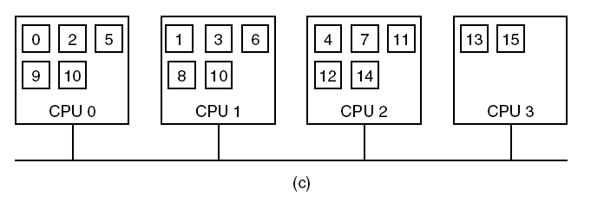
Distributed Shared Memory (6)
Figure 8-22. (c) Situation if page 10 is read only
and replication is used.
Tanenbaum, Modern Operating Systems 3 e, (c) 2008 Prentice-Hall, Inc. All rights reserved. 0-13-6006639

Slide 34
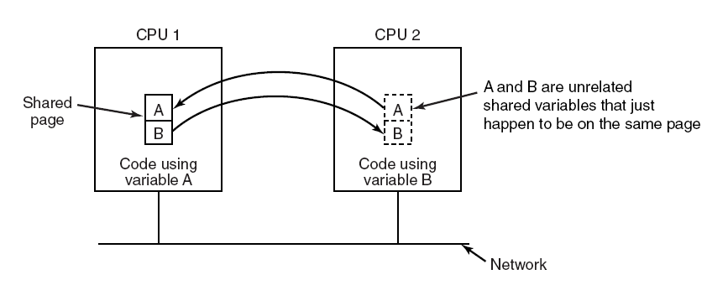
False Sharing
Figure 8-23. False sharing of a page
containing two unrelated variables.
Tanenbaum, Modern Operating Systems 3 e, (c) 2008 Prentice-Hall, Inc. All rights reserved. 0-13-6006639

Slide 35
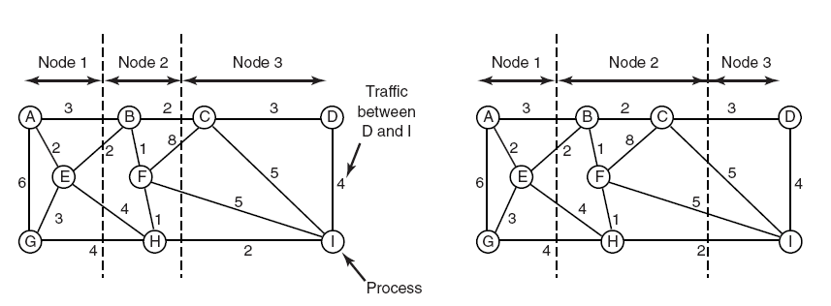
A Graph-Theoretic
Deterministic Algorithm
Figure 8-24. Two ways of allocating
nine processes to three nodes.
Tanenbaum, Modern Operating Systems 3 e, (c) 2008 Prentice-Hall, Inc. All rights reserved. 0-13-6006639

Slide 36
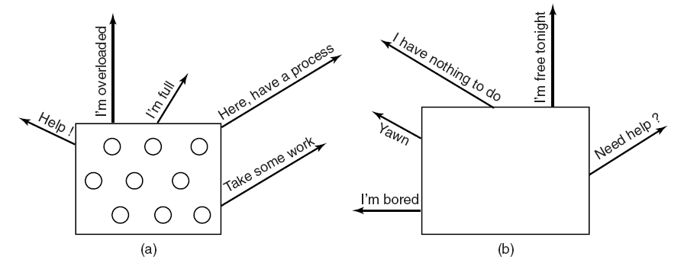
A Sender-Initiated Distributed
Heuristic Algorithm
Figure 8-25. (a) An overloaded node looking for a
lightly loaded node to hand off processes to.
(b) An empty node looking for work to do.
Tanenbaum, Modern Operating Systems 3 e, (c) 2008 Prentice-Hall, Inc. All rights reserved. 0-13-6006639

Slide 37
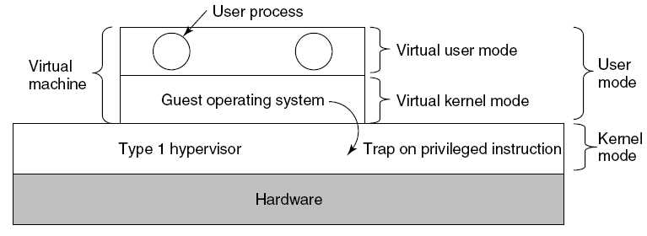
Type 1 Hypervisors
Figure 8-26. When the operating system in a virtual machine executes a kernel-only instruction, it traps to the hypervisor if virtualization technology is present.
Tanenbaum, Modern Operating Systems 3 e, (c) 2008 Prentice-Hall, Inc. All rights reserved. 0-13-6006639

Slide 38
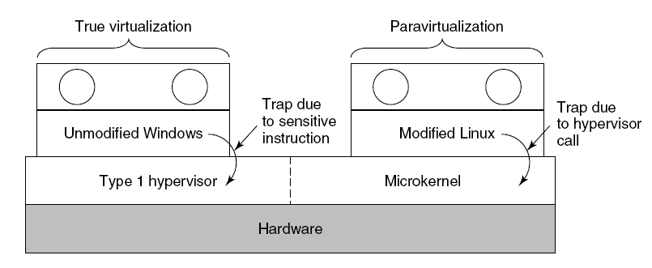
Paravirtualization (1)
Figure 8-27. A hypervisor supporting both true
virtualization and paravirtualization.
Tanenbaum, Modern Operating Systems 3 e, (c) 2008 Prentice-Hall, Inc. All rights reserved. 0-13-6006639

Slide 39
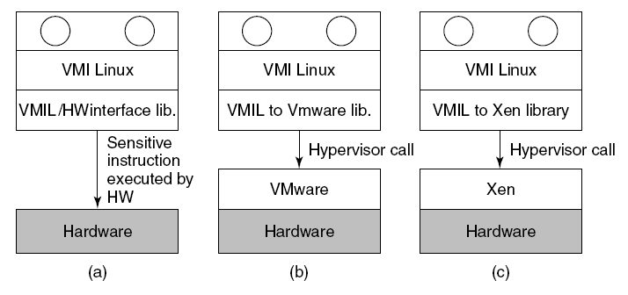
Paravirtualization (2)
Figure 8-28. VMI Linux running on (a) the bare hardware
(b) VMware (c) Xen.
Tanenbaum, Modern Operating Systems 3 e, (c) 2008 Prentice-Hall, Inc. All rights reserved. 0-13-6006639

Slide 40
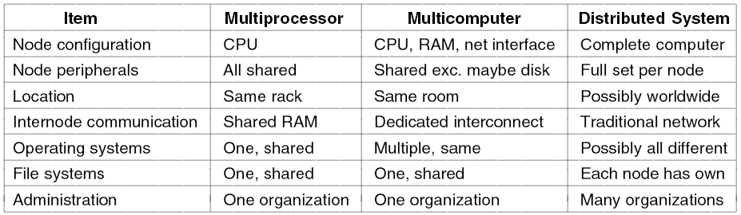
Distributed Systems (1)
Figure 8-29. Comparison of three kinds of multiple CPU systems.
Tanenbaum, Modern Operating Systems 3 e, (c) 2008 Prentice-Hall, Inc. All rights reserved. 0-13-6006639

Slide 41
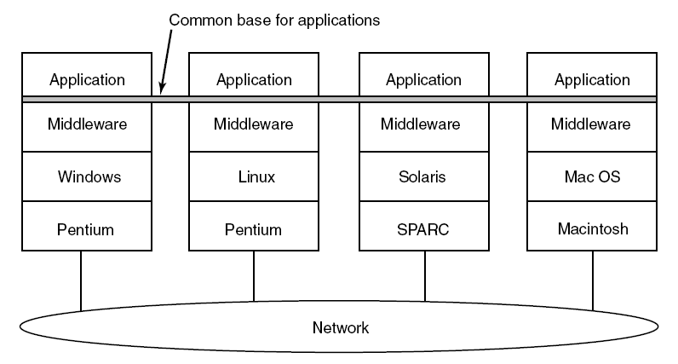
Distributed Systems (2)
Figure 8-30. Positioning of middleware in a distributed system.
Tanenbaum, Modern Operating Systems 3 e, (c) 2008 Prentice-Hall, Inc. All rights reserved. 0-13-6006639

Slide 42
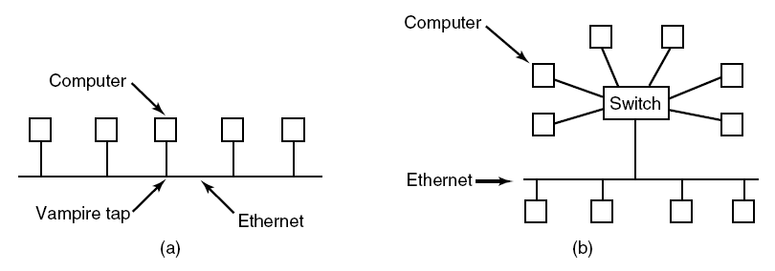
Ethernet
Figure 8-31. (a) Classic Ethernet. (b) Switched Ethernet.
Tanenbaum, Modern Operating Systems 3 e, (c) 2008 Prentice-Hall, Inc. All rights reserved. 0-13-6006639

Slide 43
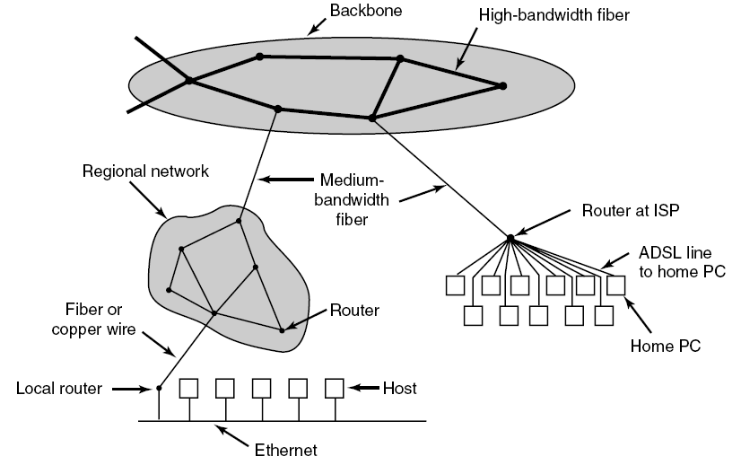
The Internet
Figure 8-32. A portion of the Internet.
Tanenbaum, Modern Operating Systems 3 e, (c) 2008 Prentice-Hall, Inc. All rights reserved. 0-13-6006639

Slide 44
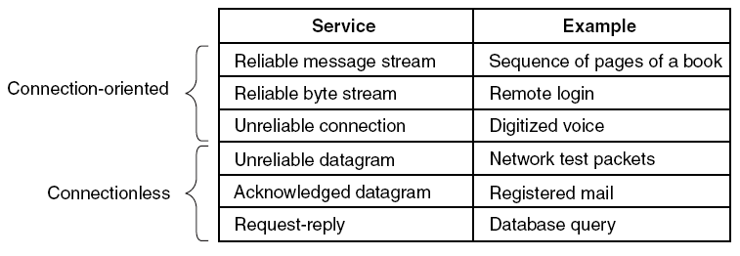
Network Protocols (1)
Figure 8-33. Six different types of network service.
Tanenbaum, Modern Operating Systems 3 e, (c) 2008 Prentice-Hall, Inc. All rights reserved. 0-13-6006639

Slide 45
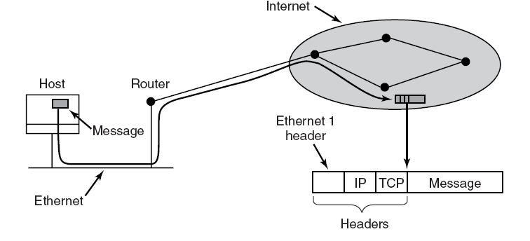
Network Protocols (2)
Figure 8-34. Accumulation of packet headers.
Tanenbaum, Modern Operating Systems 3 e, (c) 2008 Prentice-Hall, Inc. All rights reserved. 0-13-6006639

Slide 46
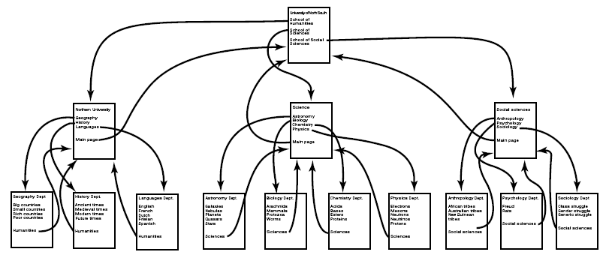
Document-Based Middleware (1)
Figure 8-35. The Web is a big directed graph of documents.
Tanenbaum, Modern Operating Systems 3 e, (c) 2008 Prentice-Hall, Inc. All rights reserved. 0-13-6006639

Slide 47
Document-Based Middleware (2)
When the browser gets the page
http://www.minix3.org/doc/faq.html.
The browser asks DNS for the IP address of www.minix3.org.
DNS replies with 130.37.20.20.
The browser makes a TCP connection to port 80 on 130.37.20.20.
It then sends a request asking for the file doc/faq.html.
. . .
Tanenbaum, Modern Operating Systems 3 e, (c) 2008 Prentice-Hall, Inc. All rights reserved. 0-13-6006639

Slide 48
Document-Based Middleware (3)
. . .
The www.acm.org server sends the file doc/faq.html.
The TCP connection is released.
The browser displays all the text in doc/faq.html.
The browser fetches and displays all images in doc/faq.html.
Tanenbaum, Modern Operating Systems 3 e, (c) 2008 Prentice-Hall, Inc. All rights reserved. 0-13-6006639

Slide 49
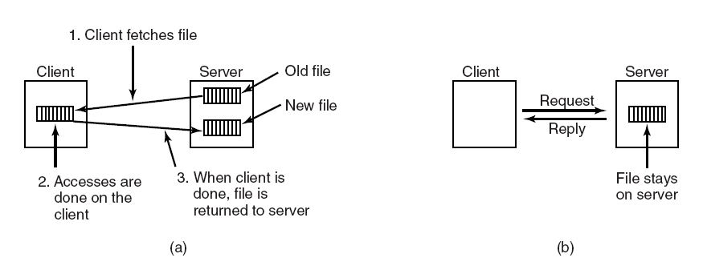
File-System-Based Middleware
Transfer Model
Figure 8-36. (a) The upload/download model.
(b) The remote access model.
Tanenbaum, Modern Operating Systems 3 e, (c) 2008 Prentice-Hall, Inc. All rights reserved. 0-13-6006639

Slide 50
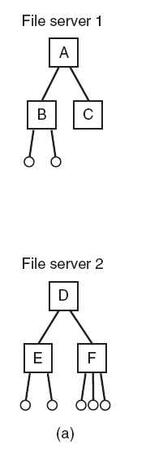
The Directory Hierarchy (1)
Figure 8-37. (a) Two file servers. The squares are directories and the circles are files.
Tanenbaum, Modern Operating Systems 3 e, (c) 2008 Prentice-Hall, Inc. All rights reserved. 0-13-6006639

Slide 51
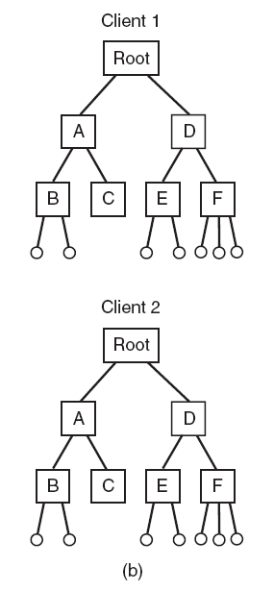
The Directory Hierarchy (2)
Figure 8-37. (b) A system in which all clients have the same view of the file system.
Tanenbaum, Modern Operating Systems 3 e, (c) 2008 Prentice-Hall, Inc. All rights reserved. 0-13-6006639

Slide 52
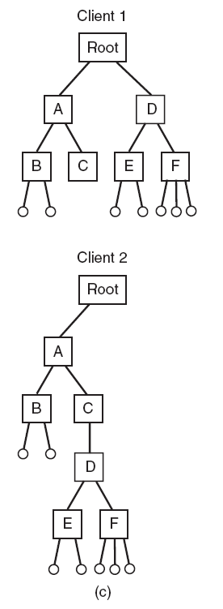
The Directory Hierarchy (3)
Figure 8-37. (c) A system in which different clients may have different views of the file system.
Tanenbaum, Modern Operating Systems 3 e, (c) 2008 Prentice-Hall, Inc. All rights reserved. 0-13-6006639

Slide 53
Naming Transparency
Three common approaches to file and directory naming in a distributed system:
Machine + path naming, such as /machine/path or machine:path.
Mounting remote file systems onto the local file hierarchy.
A single name space that looks the same on all machines.
Tanenbaum, Modern Operating Systems 3 e, (c) 2008 Prentice-Hall, Inc. All rights reserved. 0-13-6006639

Slide 54
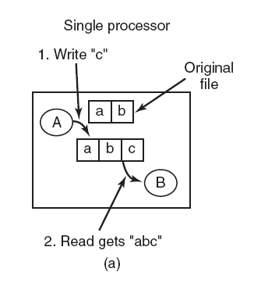
Semantics of File Sharing(1)
Figure 8-38. (a) Sequential consistency.
Tanenbaum, Modern Operating Systems 3 e, (c) 2008 Prentice-Hall, Inc. All rights reserved. 0-13-6006639

Slide 55
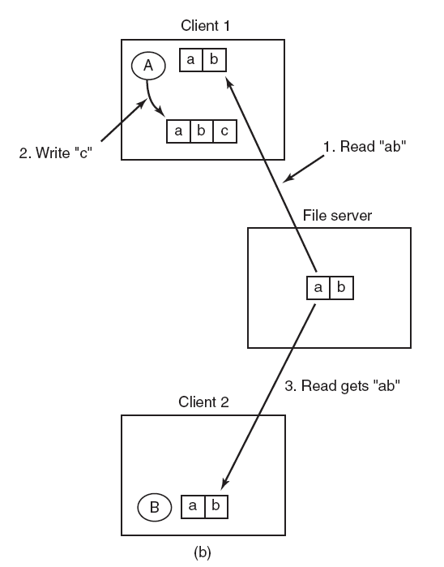
Semantics of File Sharing(2)
Figure 8-38. (b) In a distributed system with caching, reading a file may return an obsolete value.
Tanenbaum, Modern Operating Systems 3 e, (c) 2008 Prentice-Hall, Inc. All rights reserved. 0-13-6006639

Slide 56
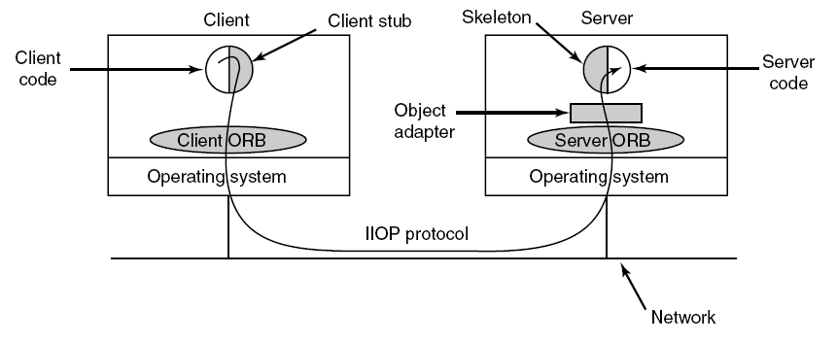
Object-Based Middleware
Figure 8-39. The main elements of a distributed system based on CORBA. The CORBA parts are shown in gray.
Tanenbaum, Modern Operating Systems 3 e, (c) 2008 Prentice-Hall, Inc. All rights reserved. 0-13-6006639

Slide 57
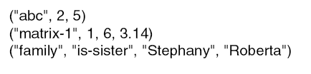
Coordination-Based Middleware (1)
Linda
A system for communication and synchronization
Independent processes communicate via an abstract tuple space
A tuple is a structure of one or more fields, each of which is a value of some type supported by the base language
Figure 8-40. Three Linda tuples.
Tanenbaum, Modern Operating Systems 3 e, (c) 2008 Prentice-Hall, Inc. All rights reserved. 0-13-6006639

Slide 58
Matching Tuples
A match occurs if the following three conditions
are all met:
The template and the tuple have the same number of fields.
The types of the corresponding fields are equal.
Each constant or variable in the template matches its tuple field.
Tanenbaum, Modern Operating Systems 3 e, (c) 2008 Prentice-Hall, Inc. All rights reserved. 0-13-6006639

Slide 59

Publish/Subscribe
Figure 8-41. The publish/subscribe architecture.
Tanenbaum, Modern Operating Systems 3 e, (c) 2008 Prentice-Hall, Inc. All rights reserved. 0-13-6006639

Slide 60
Jini
Jini clients and services communicate and synchronize using JavaSpaces.
Methods defined in a JavaSpace:
Write: put a new entry into the JavaSpace.
Read: copy an entry that matches a template out of the JavaSpace.
Take: copy and remove an entry that matches a template.
Notify: notify the caller when a matching entry is written.
Tanenbaum, Modern Operating Systems 3 e, (c) 2008 Prentice-Hall, Inc. All rights reserved. 0-13-6006639

